Slide 1
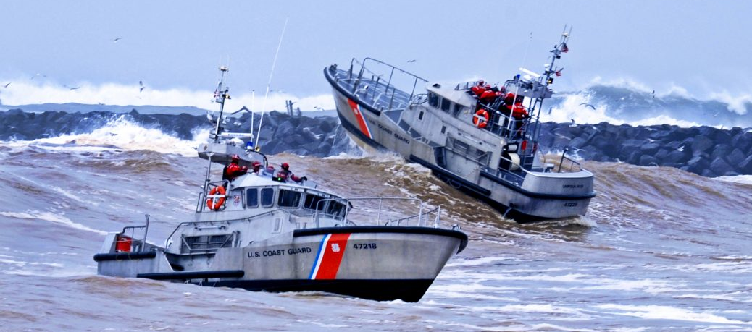
Problem Solving
Notes:
Problem Solving
We all know that if something is enjoyable it becomes easier for us to get better at. Problem-solving is just that, a skill we can become better at if we practice. Think back into your own life and how your family resolved conflicts. Were you taught how to solve your problems? Many folks have never been taught how to integrate problem solving into their everyday lives. Problem solving is the key to becoming more aware of your reactions, beliefs, attitudes and emotions associated with problematic behavior. It is believed that it is the way you think about challenges and problems which can help you build resilience and wellbeing. This is a factor of resilience which isn’t inbuilt in your genes or personality and which you do have the ability to change.

Slide 2
Learning Objectives
Coast Guard Operational
Stress Control (CG -0SC )
DEFINE and DESCRIBE the basic steps of problem solving
IDENTIFY and DISCUSS barriers to problem solving
EXPLAIN what it means to cope
IDENTIFY and DISCUSS both effective (healthy AND helpful) and problematic (unhealthy OR unhelpful) coping skills
Notes:
Learning Objectives
DEFINE and DESCRIBE the basic steps of problem solving
IDENTIFY and DISCUSS barriers to problem solving
EXPLAIN what it means to cope
IDENTIFY and DISCUSS both effective (healthy AND helpful) and problematic (unhealthy OR unhelpful) coping skills

Slide 3
Problem Solving
Coast Guard Operational
Stress Control (CG -0SC )
The process of finding solutions to difficult or complex issues to cope with everyday challenges and adversity
Effective problem solving requires time, energy, and pen-to-paper
Requires a concentrated effort on the part of the individual and will benefit from asking for help
An opportunity to learn
An effective coping skill that can bolster resilience
Notes:
Problem Solving
Discussion Questions:
-What are everyday problems that CG members encounter?
-How do you solve problems?
-What is a problem?
-How do you know when a problem is your problem?
The process of finding solutions to difficult or complex issues to cope with everyday challenges and adversity
Effective problem solving requires time, energy, and pen-to-paper
Requires a concentrated effort on the part of the individual and will benefit from asking for help
An opportunity to learn
An effective coping skill that can bolster resilience

Slide 4
Barriers to Problem Solving
Coast Guard Operational
Stress Control (CG -0SC )
Inflexible: Negative thinking
Solution: Use flexible thinking and thought changing tools
Blaming others: Lack of personal accountability
Solution: Resist the urge to blame someone for your problems
Problematic Coping: Unhealthy coping
Solution: Practice effective coping
Unrealistic goals
Solution: Set reasonable goals that align with your values
Personal attitude towards the ability to solve problems
Solution: Define the problem, provide different solutions, decide to choose the best solution and evaluate the outcome
Notes:
Barriers to Problem Solving
Discussion Questions:
-Can you think of other barriers to problem solving?
Inflexible: Negative thinking
Solution: Use flexible thinking and effective coping tools
Blaming Others: Lack of personal accountability
Solution: Resist the urge to blame someone for your problems
Problematic Coping: Unhealthy coping
Solution: Practice effective coping
Unrealistic goals
Solution: Set reasonable goals that align with your values
Personal attitude towards the ability to solve problems
Solution: Define the problem, provide different solutions, decide to choose the best solution and evaluate the outcome

Slide 5
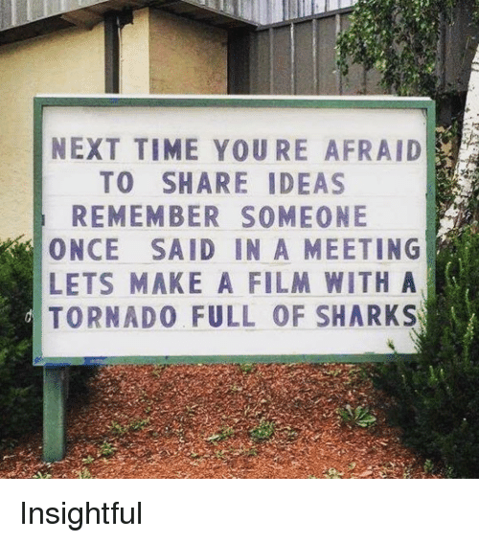
Problem Solving Steps
Coast Guard Operational
Stress Control (CG -0SC )
Identify problem & causes
Brainstorm solutions – no idea is a bad idea!
Pick one solution to start
Develop & implement your plan
Assess progress & adjust as needed
Notes:
Problem Solving Steps
Discussion Questions:
-Are you or someone you know able to solve problems quickly?
Identify the Problem:
Be specific and objective
Identify the Causes:
Think of all of the causes that might have led to the problem. Be objective and ensure there is evidence for each cause. You may want to talk to a friend or friends to make sure your perspective, ideas and/or answer(s) is/are accurate, logical, and reasonable, and that you have thought of all the possible causes behind the problem.
Brainstorm:
Think of all potential solutions to the problem. Even if you originally do not think it will work, still add it to the list (for now). Which of the potential solutions is something that you can realistically try and are willing to attempt in the near future?
Plan:
Think up a specific plan for correcting the problem, and specific steps to address each step.
Execute:
Get started working on your plan.
Adjust Course:
Check in periodically to see how your plan is working. If you are making progress, continue with the plan. If you are not making progress consider altering your plan, or move on to plan B (i.e., another potential solution you identified during brainstorming).

Slide 6
Exercise: Problem Solving
Coast Guard Operational
Stress Control (CG -0SC )
Notes:
Exercise: Problem Solving
The goal of this activity is to help participants to be familiar with the problem solving steps and to develop effective coping strategies.
Directions:
Choose one of the following scenarios below and use the problem solving steps to address the scenario:
PO Jones has fails two consecutive PFAs, and is ineligible for advancement, reenlistment or extension, he will now receive an adverse report that states significant problems on his performance evaluation. PO Jones wants to stay is the CG, but cannot seem to consistently workout and eat well with his work schedule.
LT Garcia is a Supply Officer. He is above the promotion zone and was not selected for promotion a second time. He is concerned that he will not be offered continuation and he will have to leave the CG after 15 years of service. What can I do? Probably nothing!
HM1 Brown was recently served divorce papers. She is deploying in 30 days and pre-deployment requirements are consuming her time. Her performance is plummeting and she knows it can impact her performance evaluation and opportunity to for selection to Chief Petty Officer.
CS2 Goodeats just found out that he failed the advancement exam and has major doubt he can pass the next time. His job, a wife and two very young kids consume his time.
ET2 Yellsalot is in a very tumultuous relationship. He is a very jealous person, and gets angry and has very negative thoughts about what his girlfriend might be doing when he is underway. Besides his girlfriend tiring of his jealousy and anger issues, his anger and associated negative thoughts are manifesting in negative behaviors, and he has been counseled a few times by his LPO.
Time Allotted: 10 minutes
Discussion Question:
-Can the use of problem solving make you more likely to succeed in reaching your goals?

Slide 7
Coping Skills
Coast Guard Operational
Stress Control (CG -0SC )
Coping is the process of managing demanding circumstances, solving personal and interpersonal problems, and seeking to reduce or tolerate stress or conflict
Coping skills are actions you take to deal with or reduce stress
Problematic coping skills are unhealthy OR unhelpful
Positive coping skills are functional, healthy AND helpful, and they are aligned with our values
Rigid thinking and poor coping can make problems seem overwhelming, leading to inaction
Being aware (mindful) of your current habits helps you to evaluate if your "go-to" coping skills are actually effective
Notes:
Coping Skills
Discussion Questions:
-Has anyone heard the term ‘coping skill’ before?
-What do you think this term means?
-What is an example of a coping skill?
Coping is the process of managing demanding circumstances, solving personal and interpersonal problems, and seeking to reduce or tolerate stress or conflict
Coping skills are actions you take to deal with or reduce stress
Problematic coping skills are unhealthy OR unhelpful
Effective coping skills are functional, healthy AND helpful, and they are aligned with our values
Rigid thinking and poor coping can make problems seem overwhelming, leading to inaction
Being aware (mindful) of your current habits helps you to evaluate if your "go-to" coping skills are actually effective

Slide 8
Enhancing Your Coping Skills
Coast Guard Operational
Stress Control (CG -0SC )
Mind | Body | Spirit | Social
Living according to your values Flexible thinking Optimism Behavior control Problem solving | Physical activity Healthy diet Quality of sleep Taking care of injuries and illnesses | Prayer Meditation Quiet reflection Long walks Appreciating mother nature Acts of altruism Practicing & participating in your faith or religion | Developing & maintaining a trusted social support system
Notes:
Enhancing Your Coping Skills
Discussion Questions:
-What are some ways to enhance your coping skills?
-Are they effective or unhelpful?
Everyone copes differently. What is healthy and helpful for one person might not be for someone else... find what works for you!
There are four domains of effective coping that can improve your ability to cope with stress and increase resilience:
Mind: Optimism - Flexible Thinking - Behavior Control - Problem Solving - Living according to your values
-Do your thoughts support or detract from your health?
-Are you taking responsibility for your own mental health
Body: Physical activity - Healthy diet - Quality of sleep - Taking care of injuries and illnesses
-Are you exercising regularly?
-Are you maintaining a healthy weight?
-Do you have a balanced diet?
-Are you getting enough quality sleep?
-What else can you do to improve your physical health?
Spirit: Prayer - Meditation - Quiet reflection - Long walks - Appreciating mother nature - Acts of altruism - Practicing and participating in your faith or religion
-When was the last time you did something fulfilling?
-What can you do that is meaningful and will help you to reduce stress?
Social: Developing & maintaining a trusted social support system (actively seeking and promoting such relationships). Social support is particularly important during periods of adversity and sustained life stress.
-Do you have a trusted social support system?
-What can you do to strengthen or increase your social support?
-Who can you talk to if you need help?

Slide 9
Exercise: Effective Coping
Coast Guard Operational
Stress Control (CG -0SC )
Notes:
Exercise: Effective Coping
*Facilitator choose between Effective Coping #1 OR Effective Coping #2 to complete in class
The goal of these exercises is to help participants recognize effective (healthy AND helpful) and problematic (unhealthy OR unhelpful) coping skills.
Positive Coping #1:
Directions:
1. Individually OR in a group list both effective (healthy AND helpful) coping skills for the 4 domains (mind, body, spirit and social).
2. List activities you would like to do, or think are important that support these skills
3. Generate a discussion regarding coping skills. Give examples of your coping skills
Time Allotted: 10 minutes
Discussion Questions:
-Did any of your coping strategies surprise you?
Positive Coping #2:
Directions:
1. Individually OR in groups list both effective (healthy AND helpful) and problematic (unhealthy OR unhelpful) coping skills.
2. Compare the 2 lists: Do the problematic coping skills outnumber the effective? If so, ask the audience why this is so? This will generate a discussion. It is easier to have unhealthy “go to” coping skills to resolve problems.
Time Allotted: 10 minutes
Discussion Questions:
-Did any of your coping strategies surprise you?

